Slide 1
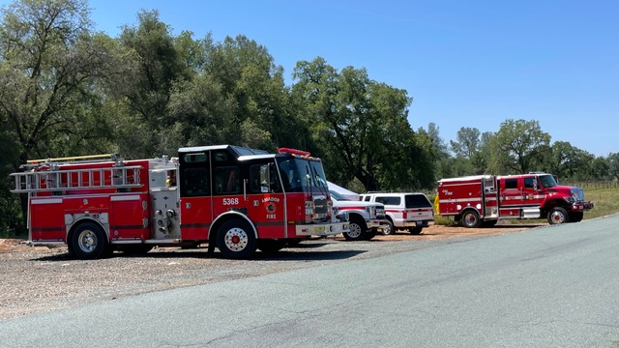
SUSTAINING A FIREWISE COMMUNITY
Increasing Your Wildfire Survivability
Burke Ranch Property Owners Association Firewise USA Community

Slide 2
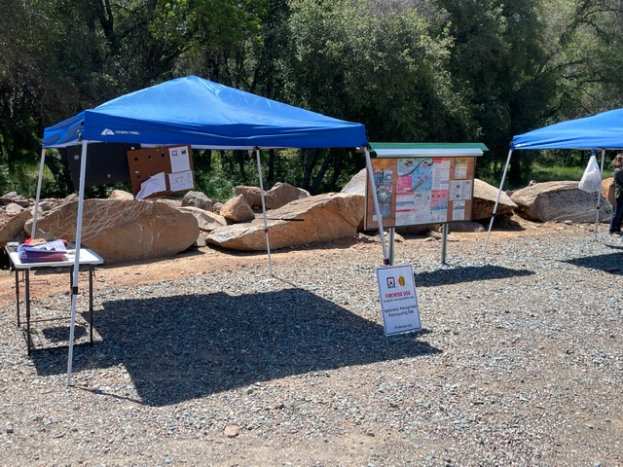
OVER 600 FIREWISE COMMUNITIES STATEWIDE
SOME BENEFITS…………….
-Ensure your home is more fire resistant
-Ensure your community is more fire resistant
-Collaboration with local fire agencies
-Potential insurance reduction
-Opportunity for grant funding
-Partner to make Amador more fire resistant
-Proactive model for future behavior

Slide 3
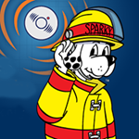
Sustaining a Firewise Community: How do you sustain Firewise??
Communication:
Keep your residents informed
Motivation:
Conduct exercises, workshops,
Partnership:
Collaborate with local fire agencies and other stakeholders

Slide 4
Sustaining a Firewise Community: How do you sustain Firewise??
Grants:
Propose community grant projects
Celebrate your achievements:
Social events, Certificates, Awards

Slide 5
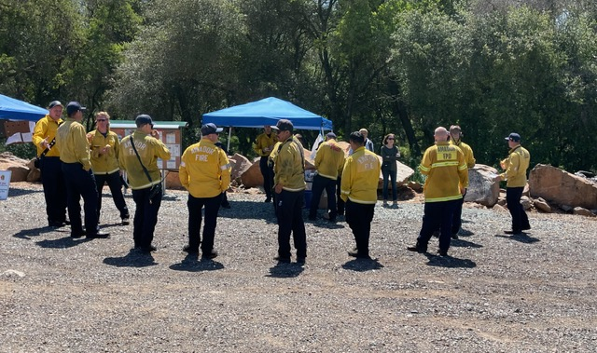
QUESTIONS: SUSTAINING A FIREWISE COMMUNITY
Increasing Your Wildfire Survivability
Burke Ranch Property Owners Association Firewise USA Community
Barbara J MCPhail EdD - Firewise Committee Chair – ltcbjmr@gmail.com – (707) 583-5614

